Slide 1

TRANSFER PRICING IN ARGENTINA
MIAMI, June 10, 2000

Slide 2
CURRENT SITUATION IN ARGENTINA
Legislation in force
Proceedings carried out before the Argentine Chamber of Medicines
New strategy to defend pricing policies - Functional analysis preparation
Business relationships to be taken into consideration
Pricing Study
Business Transactions carried out during 1999
June 10, 2000

Slide 3

LEGISLATION IN FORCE
June 10, 2000

Slide 4
CURRENT SITUATION IN ARGENTINA
Legislation in Force:
Law 25.063 (in force since 31.12.98)
Decree 485/99 (published on 12.05.99)
General Resolution 702/99 (published on 15.10.99)
Law 25.239 (in force since 1/1/2000)
RATIFICATION OF THE ARM’S LENGTH PRINCIPLE
ENFORCEMENT OF THE METHODS SUGGESTED BY THE OECD.
June 10, 2000

Slide 5
LEGISLATION IN FORCE- LAW 25.063
Section 8º:
Modified by Law 25.239 (currently applicable since 1/1/2000 for unrelated companies)
EXPORTS:
Should prices not be fixed or should those agreed upon be lower than the wholesale price in effect at the place of destination, the later shall be taken into consideration in order to determine the value of exported goods. Tax Authorities are empowered to determine export values.
IMPORTS:
If sale prices in the country are higher than those existing at the place of origin, the difference shall be deemed to be an Argentine source net profit for the foreign exporter. Tax Authorities are empowered to determine import values.
June 10, 2000

Slide 6
LEGISLATION IN FORCE- LAW 25.063
SECTION 15º
TRANSFER PRICES:
Related companies shall determine their profits and expenses, to be assessed according to values deriving from business relationships considered as among unrelated parties in comparable transactions.
To determine whether transfer prices are consistent with customary market practices among unrelated parties, the MOST APPROPRIATE method of those hereinafter mentioned, shall be applied.
June 10, 2000

Slide 7
LEGISLATION IN FORCE- LAW 25.063
Methods based on comparable transactions :
Comparable Uncontrolled Price Method
Resale Price Method
Cost Plus Method
Methods based on Comparable Company Profits:
Profit Split Method
Residual Profit Split Method
Transactional Net Margin Method
June 10, 2000

Slide 8

PROCEEDINGS BEFORE THE ARGENTINE CHAMBER OF MEDICINES
June 10, 2000

Slide 9
PROCEEDINGS BEFORE THE ARGENTINE CHAMBER OF MEDICINES
The different Aspects having incidence on the Pharmaceutical Industry were Analysed in Depth in order to achieve Consensus and to create an Awareness of this new “Transfer Pricing” issue.
June 10, 2000

Slide 10
PROCEEDINGS BEFORE THE ARGENTINE CHAMBER OF MEDICINES
We have emphasized the special characteristics of the basic Research and Development functions in our industry, mentioning among others, the following notions:
synthesis of substances and their supervision
pre-clinical developments
biological and toxicological essays
efficacy and tolerance tests in humans
June 10, 2000

Slide 11
PROCEEDINGS BEFORE THE ARGENTINE CHAMBER OF MEDICINES
Nature of manufacturing process (the active ingredient discovered by Parent Company is not modified).
Local company purchases the majority of active ingredients and products from its Parent Company.
Parent Companies release their related companies from most risks.
June 10, 2000

Slide 12
PROCEEDINGS BEFORE THE ARGENTINE CHAMBER OF MEDICINES
Within the problems facing the foreign capital pharmaceutical industry, the following ones were pointed out:
the meaning of Research and Development expenses incurred by Parent Company
impossibility of transferring Research And Development expenses to finished products
existence of few successful but very well known products
profits must cover the costs of failures
profits are related to the extent of the risks assumed
years taken for the Research and Development of an effective molecule (10 to 15 years)
June 10, 2000

Slide 13
PROCEEDINGS BEFORE THE ARGENTINE CHAMBER OF MEDICINES
We want to point out that in the Argentine Pharmaceutical Industry there are labs which:
Invest in research and development at a worldwide level
do not invest in research
June 10, 2000

Slide 14
PROCEEDINGS BEFORE THE ARGENTINE CHAMBER OF MEDICINES
“Transfer Pricing” was submitted to the Executive Committee of the Argentine Chamber of Medicines (CAEME) in order to make such authorities become involved in such issue, so that they notify the relevant executives at the labs that are members of the Chamber.
This issue (which may be considered technical in the first place) should be raised at the highest executive level within the organizations, as it could have an effect on policies to be followed.
June 10, 2000

Slide 15
PROCEEDINGS BEFORE THE ARGENTINE CHAMBER OF MEDICINES
A meeting was held at the Argentine Chamber of Medicines, being Dr. Rodriguez Usé, UnderSecretary of Public Revenues of the Ministry of Economy, officials from the Administración Federal de Ingresos Públicos and members of the Tax Committee present. The purpose of such meeting was to create an awareness of the special characteristics of the Pharmaceutical Industry and to express our view as regards the Transfer Pricing issue for this Industry.
June 10, 2000

Slide 16
PROCEEDINGS BEFORE THE ARGENTINE CHAMBER OF MEDICINES
We have submitted data to the tax advisor at the Chamber in order to establish the link between the pharmaceutical industry problems and the tax technical aspect, to inform Tax Authorities that products imported by national laboratories are not comparable with products imported by multinational labs.
June 10, 2000

Slide 17

PRICING POLICY STRATEGIES
- FUNCTIONAL ANALYSIS PREPARATION -
June 10, 2000

Slide 18
PRICING POLICY STRATEGY
- FUNCTIONAL ANALYSIS PREPARATION -
We have decided that it is convenient to include in the functional analysis a summary of the situation of this industry in our country. It is obvious that characteristics inherent to the local industry may or may nor help to defend our pricing policy. We believe that given the characteristics of the Argentine industry it is advisable to include such information in our analysis.
June 10, 2000
June 10, 2000

Slide 19
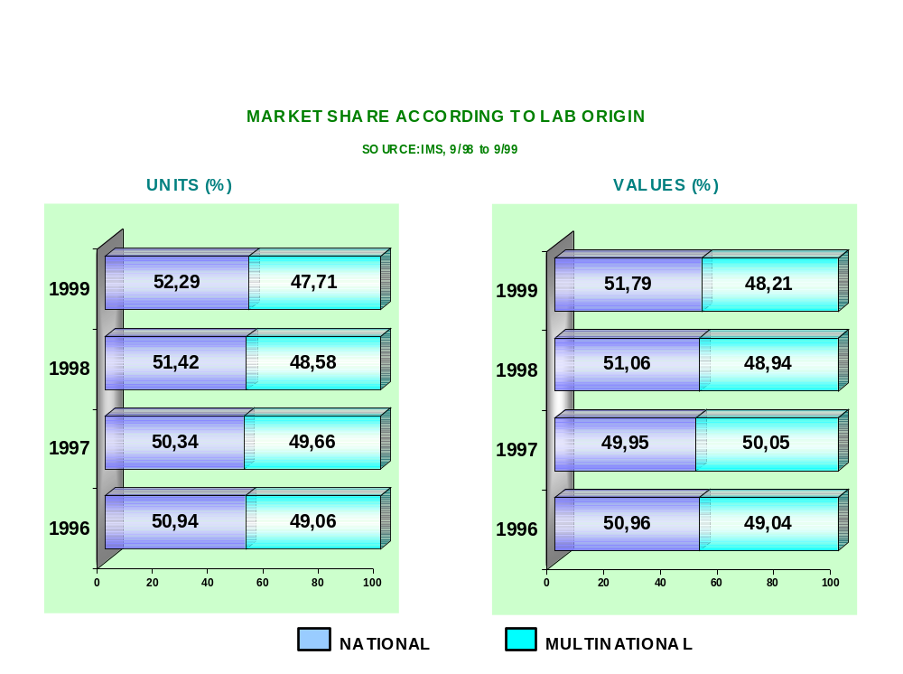
ARGENTINE PHARMACEUTICAL MARKET
June 10, 2000

Slide 20
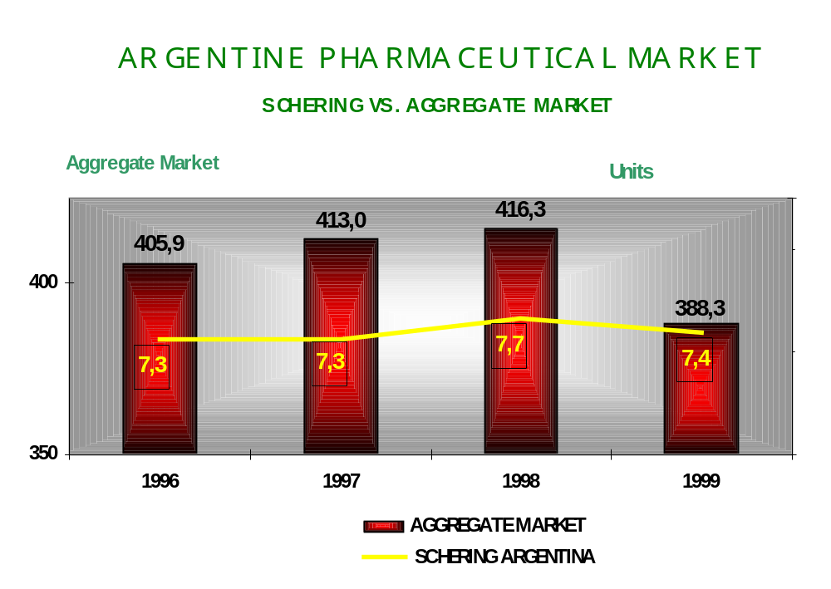
June 10, 2000

Slide 21
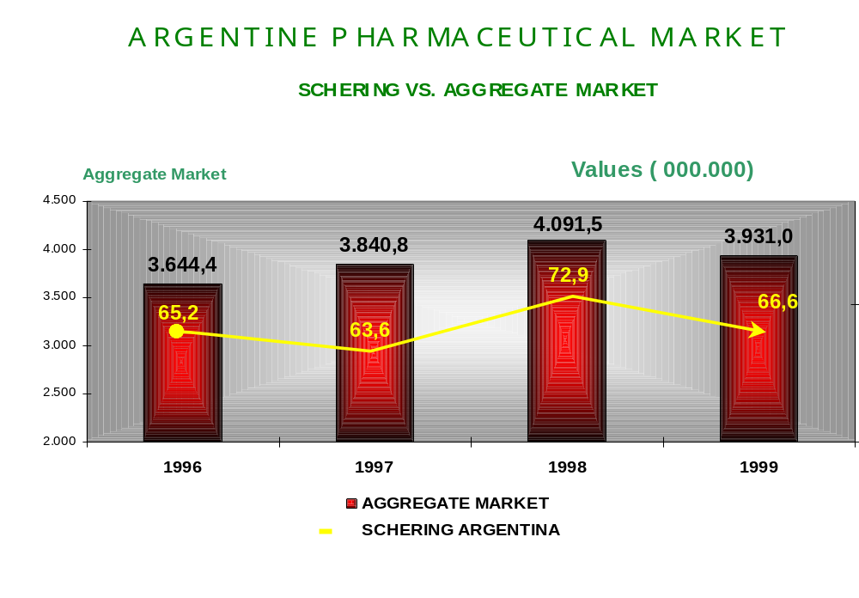
June 10, 2000

Slide 22
AVERAGE WEIGHTED PRICE
Medicine Wholesaler level Pharmacy without VAT
1/1999 to 12 / 1999 3/1999 to 3/2000
Year 1999 Year 2000
PHARMACEUTICAL INDUSTRY 10.13 10.15
SCHERING 8.61 8.68
NATIONAL LABS 9.74 9.76
MULTINATIONAL LABS 10.58 10.67
Source: IMS December ‘99 and March’ 00
June 10, 2000

Slide 23
WEIGHTED AVERAGE PRICE
HORMONAL CONTRACEPTIVES
Medicine Wholesaler Level Pharmacy without VAT
Hormonal Contraceptives
(average market price) 7.94 $ /unit
SCHERING (Multinational) 7.64 $ / unit
WYETH (Multinational) 8.72 $ / unit
ORGANON (Multinational) 8.95 $ / unit
GADOR (National) 7.58 $ / unit
ELEA (National) 9.18 $ / unit
June 10, 2000

Slide 24
PRICING POLICY STRATEGY
- FUNCTIONAL ANALYSIS PREPARATION -
The purpose of a Transfer Pricing study is to evaluate whether intercompany transactions have been carried out observing the arm’s length principle.
One of the objectives of the Transfer Pricing study is to reduce the chances of possible adjustments, if any. In Argentina, attention must be paid to the Income Tax Law (with modifications introduced by means of Law 25.064 and 25.239) and by General Resolution Nº702 (G.R. 702/99).
June 10, 2000

Slide 25
PRICING POLICY STRATEGY
- FUNCTIONAL ANALYSIS PREPARATION - -
As regards the procedure used to evaluate the market value of intercompany transactions under study, methods used shall have to be consistent with the Pricing Policy of Schering Group at a worldwide level and with that suggested by external consultants, in order to minimize contingencies.
Generated documentation may be used in the case of a Transfer Pricing inspection, a controversy before argentine courts, a procedure undertaken by the relevant authorities or a foreign arbitration procedure .
June 10, 2000

Slide 26
PRICING POLICY STRATEGY
- FUNCTIONAL ANALYSIS PREPARATION -
If it is necessary to resort to the profit - based methods, arm’s length companies shall be sought through international databases providing the information necessary for preparing the analysis.
In this sense, we have arrived at the conclusion that additional methods may be employed, to be used as back-up to those adopted by the group.
June 10, 2000

Slide 27

BUSINESS RELATIONSHIPS TO BEAR IN MIND
June 10, 2000

Slide 28
BUSINESS RELATIONSHIPS
TO BEAR IN MIND
Business relationships with Schering Aktiengesellschaft:
  Imports of raw materials
  Bulk imports
  Imports of finished products
  Bulk exports
  Exports of finished products
  Royalty payments
  Credits for expense reimbursements
  Debits for expense reimbursements
June 10, 2000

Slide 29
BUSINESS RELATIONSHIPS
TO BEAR IN MIND
Business relationships with Schering do
Brasil, Química e Farmacéutica Ltda.:
  Bulk imports
  Imports of finished products
  Manufacturing and packaging process
  Exports of finished products
  Credits for expense reimbursements
  Debits for expense reimbursements
June 10, 2000

Slide 30
BUSINESS RELATIONSHIPS
TO BEAR IN MIND
Business relationships with Schering Mexicana S.A. de C.V.:
Manufacturing of products to be exported
Packaging process
Exports of finished products
Use of SAP server
Credits for expense reimbursements
Debits for expense reimbursements
Business relationships with Schering las Américas S.A.:
Manufacturing of products to be exported
Bulk imports
Packaging of finished products
Packaging of imported bulk
Exports of finished products
June 10, 2000

Slide 31
BUSINESS RELATIONSHIPS
TO BEAR IN MIND
Business relationships with Schering Colombiana:
Bulk manufacturing
Manufacturing of finished products
Packaging of imported bulk
Packaging of manufactured products
Bulk exports
Exports of finished products
Credits for expense reimbursements
Debits for expense reimbursements
June 10, 2000

Slide 32
BUSINESS RELATIONSHIPS
TO BEAR IN MIND
Business relationships with Schering Uruguaya S.A.:
Manufacturing of finished products
Bulk manufacturing
Product packaging
Exports of imported bulk
Exports of finished products
Credits for expense reimbursements
Debits for expense reimbursements
Business relationships with Schering Peruana S.A.:
Manufacturing of finished products
Bulk manufacturing
Product packaging
Packaging of imported bulk
Exports of finished products
Debits for expense reimbursements
June 10, 2000

Slide 33
BUSINESS RELATIONSHIPS
TO BEAR IN MIND
Business relationships with Schering de Venezuela S.A.:
Manufacturing of finished products
Manufacturing and packaging process
Packaging of finished products
Packaging of imported bulk
Exports of finished products
Credits for expense reimbursements
Debits for expense reimbursements
Business relationships with Schering de Chile S.A.:
Manufacturing of finished products
Bulk manufacturing
Product packaging
Packaging of imported bulk
Exports of finished products
Debits for expense reimbursements
June 10, 2000

Slide 34
BUSINESS RELATIONSHIPS
TO BEAR IN MIND
Business relationships with Proquina S.A. de C.V.:
Imports of raw materials
Debits for expense reimbursements
Business relationships with Schering Wien G.m.b.H.:
Loan interest payments
Purchase of machinery
Business relationships with Germapharm G.m.b.H.:
Imports of raw materials
June 10, 2000

Slide 35
BUSINESS RELATIONSHIPS
TO BEAR IN MIND
Business relationships with Leiras Oy:
Bulk imports
Business relationships with Farmades SpA.:
Imports of machinery
Business relationships with Schering
Ecuatoriana C.A. Industrial y Comercial:
Debits for expense reimbursements
June 10, 2000

Slide 36
BUSINESS RELATIONSHIPS
TO BEAR IN MIND
Business relationships with Schering Boliviana Ltda.:
Debits for expense reimbursements
Business relationships with Schering Guatemalteca S.A.:
Debits for expense reimbursements
Business relationships with Schering Dominicana S.A.:
Debits for expense reimbursements
June 10, 2000

Slide 37

PRICING STUDY
Schering Argentina S.A.I.C.
June 10, 2000

Slide 38
PRICING STUDY
We have defined the convenience of incorporating in our functional analysis, a chapter on Schering AG’s transfer pricing policy in order to strengthen the situation of the argentine subsidiary in the country.
We evaluate the need to know whether Schering AG supplies the same active ingredientes to other domestic labs, as in the case of John Wyeth which purchases Gestoden. If this happens, we should be informed as this would be the case of comparable companies in the country.
June 10, 2000

Slide 39
PRICING STUDY
We have approached the Pricing Study from different points of view in order to analize its compatibility with imports and exports prices, terms of payment, royalties, loans, financing (capitalization), that is to say:
  Gross profit analysis, per product and per segment
  Import price analysis as regards other labs
  Analysis of raw materials per country of origin and per product
  Analysis from a global point of view related to prices/ terms/ royalties
June 10, 2000

Slide 40
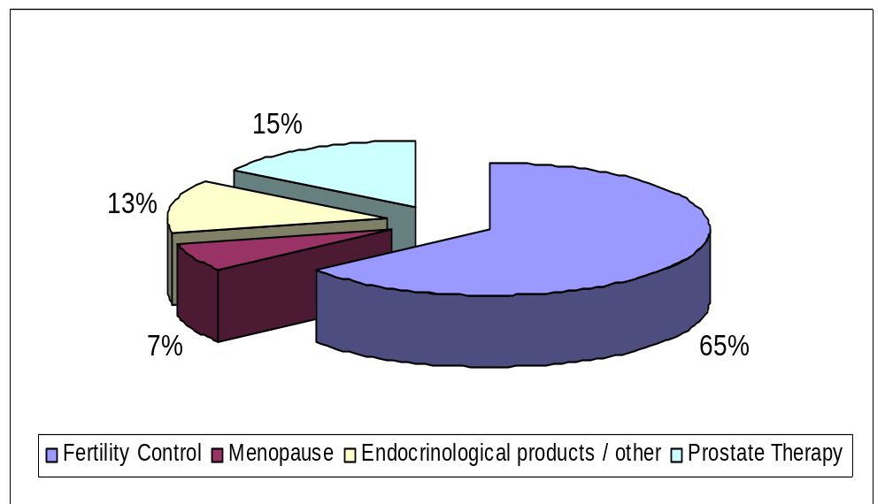
EFFECTIVE SALES 1999
June 10, 2000

Slide 41
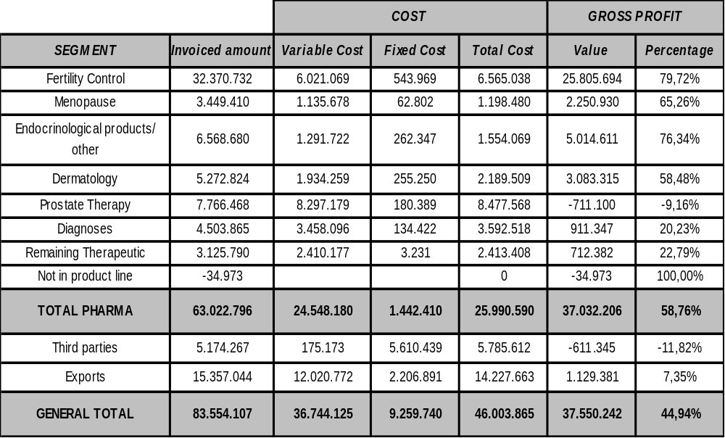
EFFECTIVE SALES 1999
PER SEGMENTS
June 10, 2000

Slide 42
IMPORTS
We shall specify import prices for some active ingredients that appear on the records of the General Customs Office, entity that depends on the Administración Federal de Ingresos Públicos.
In some cases, such substances enter the country both through labs and through medicine wholesalers which subsequently sell them on the local market.
June 10, 2000

Slide 43
IMPORTS
HYDROCORTISONE: Kg. FOB value in US$
Schering Arg S.A.I.C. 3.484,00
Carpe-Scheider y cia.S.A. 1.080,00
Pfizer S.R.L. 1.007,33
Roemmers S.A.I.C.F. 942,95
Glaxo Wellcome S.A. 937,77
Monsanto Arg.S.A.I.C. 925,00
Lab. Temis Lostalo S.A. 896,31
Drawer S.A. 866,58
Hoechst Marion Roussel S.A. 850,00
Unifarma S.A. 817,53
Lab. Pablo Cassara S.R.L. 721,00
Drog.Saporiti Sacifia 590,90
June 10, 2000

Slide 44
IMPORTS
ISOCONAZOLE NITRATE: Kg. FOB value in US$
Schering Argentina S.A.I.C. 6.000
(Sole importer in the country)
DIFLUCORTOLONE VALERATE :
Schering Argentina S.A.I.C. 92.700
(Sole importer in the country)
June 10, 2000

Slide 45
IMPORTS
NEOMYCIN SULFATE: Kg. FOB value in US$
Carpe-Scheider y cia. S.A. 11.786,66
Cientifica Balmor Integral S.A. 9.785,00
Glaxo Wellcome S.A. 591,36
Schering Argentina S.A.I.C. 293,42
Lab. Dallas S.A. 97,92
Schering-Plough S.A. 82,02
Lab. Tems Lostalo S.A. 52,76
Lab. Northia S.A.C.I.F. 48,91
Unifarma S.A. 42,58
Inmobal Nutrer S.A. 24,81
Romkin S.A. 24,38
Drog. Beiro S.R.L. 23,13
June 10, 2000

Slide 46
IMPORTS
CYPROTERONE ACETATE:
Kg. FOB value in US$
Schering Arg. S.A.I.C. 32.000,00
Lab. Rontag S.A. 13.500,00
Labinca S.A. 12.977,32
Lab. Flaxis S.A. 12.000,00
Lab. Fabra S.R.L. Resol. 11.715,00
Lab. Varifarma S.A. 11.179,43
Lab. Kampel Martian S.A. 10.953,03
Asofarma S.A. Indu. 6.085,00
Elvetium S.A. 5.123,56
Lab.Prof.Dr.Raffo S.A. 5.017,19
Lab. Richmond S.A.C.I.F. 4.844,00
Delta Farma S.R.L. 4.466,42
Microsules Arg. S.A de S 4.294,00
June 10, 2000

Slide 47
PRICING STUDY
Economic facts concerning royalties are being analyzed through the different laws:
Laws related to the royalty issues
Tax laws
Transfer Pricing rules
June 10, 2000

Slide 48


Business transactions carried out during 1999
Schering Argentina S.A.I.C.
June 10, 2000

Slide 49
Transactions that have been declared before Tax Authorities year 1999
(in thousands of US$)
Exports:
Schering do Brasil Ltda. 8.812
Schering Aktiengesellschaft 3.258
Schering Colombiana S.A. 1.229
Schering Mexicana S.A. 754
Schering Peruana S.A. 657
Schering Uruguaya S.A. 561
Schering de Venezuela S.A. 70
Schering de Chile S.A. 16
TOTAL: 15.357
Purchases to group companies:
Schering Aktiengesellschaft 25.331
Germapharm G.m.b.H. 4.053
Schering do Brasil Ltda. 3.675
Proquina S.A. de C.V. 531
Schering las Américas S.A. 79
Schering Wien S.A. G.m.b.H. 40
Farmades Spa 16
Leyras Oy 7 TOTAL: 33.732
June 10, 2000

Slide 50
Transactions that have been declared
before Tax Authorities year 1999
(in thousands of US$)
Royalty payments for use of trademark:
Schering Aktiengesellschaft 1.329
Loan Interest payments:
Schering Wien G.m.b.H. 741
June 10, 2000

Slide 51
Transactions that have been declared before Tax Authorities year1999
(in thousands of US$)
Credits as expense reimbursements:
Schering Mexicana S.A. de C.V. 161
Schering de Venezuela 52
Schering do Brasil Ltda. 41
Schering Aktiengesellschaft 28
Schering Uruguaya S.A. 9
Schering Colombiana S.A. 5
TOTAL: 296
June 10, 2000

Slide 52
Transactions that have been declared before Tax Authorities year 1999
(in thousands of US$)
Debits as expense reimbursements :
Schering do Brasil Ltda. 316
Schering Aktiengesellschaft 86
Schering Mexicana S.A. de C.V. 18
Schering Colombiana S.A. 16
Schering Uruguaya S.A. 11
Proquina S.A. de C.V. 9
Schering de Chile S.A. 8
Schering Peruana S.A. 7
Schering de Venezuela S.A. 7
Schering Ecuatoriana S.A. 6
Schering Dominicana S.A. 5
Schering Guatemalteca S.A. 5
Schering Boliviana Ltda. 4
TOTAL: 498
June 10, 2000

